Slide 1
Power Magazine Visuals
June 28, 2012
© 2012 San Diego Gas & Electric Company.
All trademarks belong to their respective owners. All rights reserved.
Notes:
Introduction and Welcome
Good morning and thank you for attending the Grid Com Forum West. I would like to welcome to all of our SDG&E employees, as well as our special guests, local community partners and forum sponsors. We look forward to an engaging and successful time together.
The purpose of this forum is to focus on virtually every aspect of the smart grid, including how it is changing our industry and helping to improve peoples’ lives. We truly have an all-star lineup of speakers here this week, so please take the opportunity to listen and learn from these top experts about this vitally important topic.
To start off this morning, I would like to focus particular attention on how SDG&E is taking the lead in the effort to develop the smart grid across the nation.

Slide 2
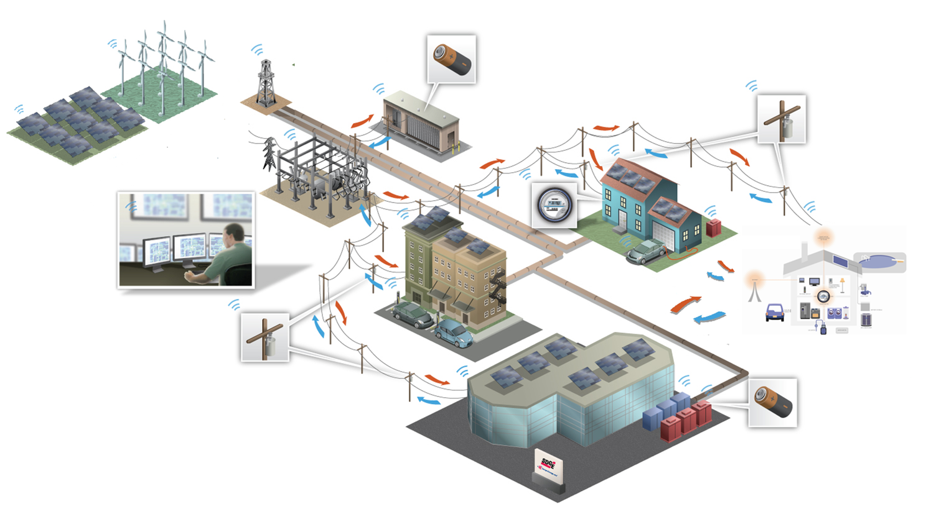

Research, Development & Demonstration:
SDG&E Borrego Springs Microgrid Project
Description | In cooperation with the US Department of Energy and the California Energy Commission, SDG&E along with public and private sector partners are developing a “microgrid” project – a small version of its smart electric grid.
Benefits: | Integrate and leverage various generation and storage configurations and other smart grid technologies Reduce the peak load of feeders and enhance system reliability Enable customers to become more active participants in managing their energy use
Distributed Energy Resources
Secure, 2-way Communications
Substation
Energy Storage
Customer Energy Management
Home Area Network
Microgrid Controller
Home
Energy Storage
Feeder Automation System Technology
Community
Energy Storage
2
Notes:
2
As we improve our services for customers, we are also researching and modeling every aspect of the smart grid on our system in order to refine its performance. We are creating a new “microgrid” in Borrego Springs, which will be laboratory in action for testing a range of smart grid technologies, such as new energy storage technologies and rooftop solar arrays that will create a self-sustaining grid that can survive outages on its own.
As I discussed earlier, we are installing a host of smart sensors that provide the system awareness and flexibility to integrate large amounts of clean, renewable energy seamlessly onto the grid. This is a very exciting step toward a cleaner, greener future for everyone. In addition, we have received a $28 million federal grant toward the creation of a powerful wireless communications network to support the many interconnected aspects of the smart grid.
2

Slide 3
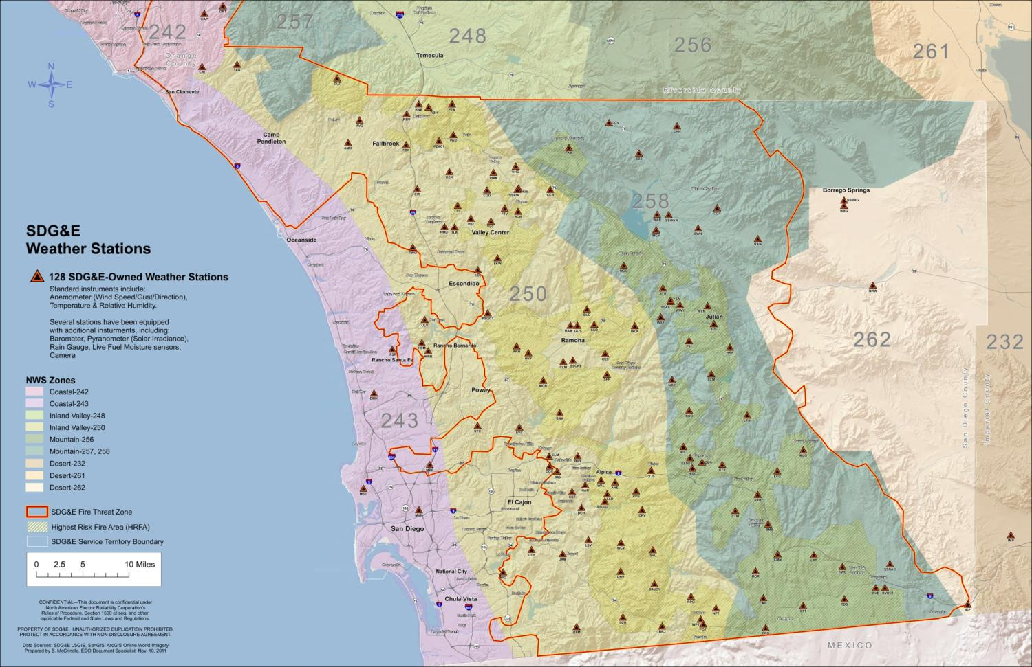
SDG&E Weather Network (128 Stations)
Notes:
SDG&E also has one of the largest and most sophisticated weather sensor networks in the nation. We have installed 128 weather sensors throughout our service territory to measure everything from temperature and humidity to wind speed and solar radiation, all of which provides a greater awareness of the state of our grid. This advanced weather network provides SDG&E real-time situational awareness for better operational decision making, thereby preparing us for the wildfire season and enhancing the reliability of our electric system overall.
As you can see, the smart grid will create a more resilient and efficient means of energy use that will empower us all to do our part for the environment and save money in the process.
You are all a part of these exciting changes and we thank you all for your important contribution to this sea change in how the region, and indeed the world, uses energy.

Slide 4
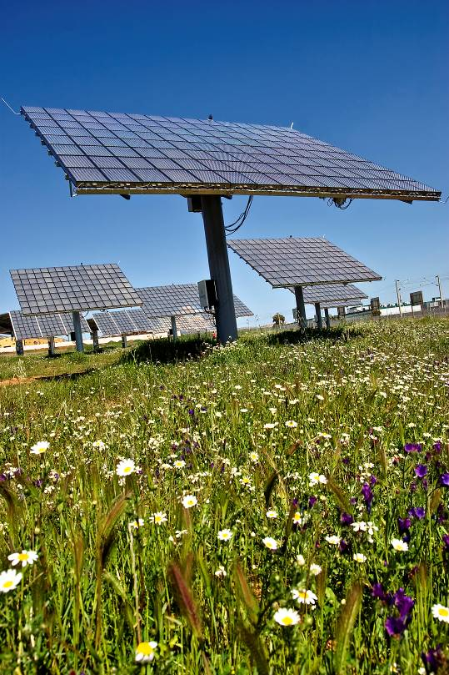
Signed 1,482 MW of Renewable Energy Contracts in 2011
Tenaska Solar Ventures: Two proposed PV facilities in Imperial Valley will deliver 270 MW of clean power across Sunrise Powerlink. Use Soitec solar panels manufactured at a new plant in San Diego, which will create 450 “green” jobs.
Pattern Wind Energy: 299 MW generated at Ocotillo Wind Energy Facility in the Imperial Valley, to flow over Sunrise Powerlink
Energia Sierra Juarez: Up to 156 MW of wind in Northern Baja California
Contracted for numerous other renewable projects that leverage ideal solar and wind resources in San Diego/Imperial Valley and Baja region
Notes:
We are making great strides in securing contracts with large, utility-scale renewable projects, which will leverage the ideal solar, geothermal and wind resources in the San Diego and Imperial Counties and Baja California region. In 2011, SDG&E signed 17 new renewable energy contracts for a combined total of 1,482 megawatts.
Many of these contracts are taking advantage of the great wind resource we have on the ridges of eastern San Diego County and the abundant sunshine in the Imperial Valley. These contracts include 299 megawatts of wind from the Pattern Wind project, and two contracts with Tenaska Solar Ventures for a combined 270 megawatts of photovoltaic solar power, all located in the Imperial Valley.
These contracts show the immense potential for renewable energy development in the greater San Diego/Imperial Valley/Baja region, which some have calculated in the total region to be about 12,000 megawatts, enough power for 6.6 million homes.

Slide 5
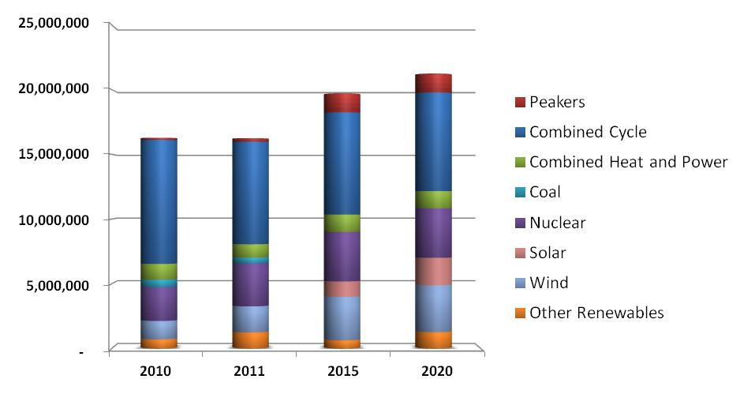
Changing San Diego Energy Mix
Renewable Portfolio Standard Percentages
33%
24%-28%
11.9%
20.8%
Energy mix for 2015 and 2020 are subject to substantial uncertainty
Values are for illustration purposes and do not represent forecasts
5
Notes:
5

Slide 6
Commercial & Residential Generation
6

Slide 7
Integration of DER Solar & Electric Vehicle Customers
7
Notes:
7

Slide 8
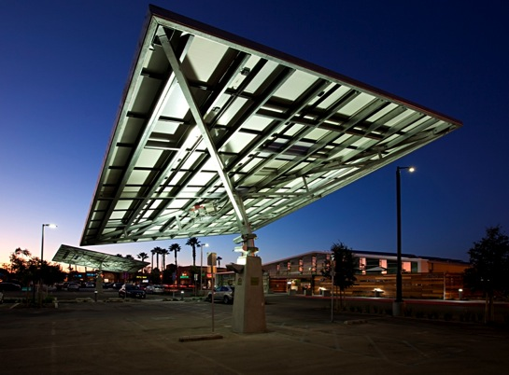
Rooftop Solar Innovations
100 MW Solar Initiative
26 MW of SDG&E-owned and 74 from independent producers
Share the Sun and Sun Rate provide innovative solar opportunities to customers
© 2012 San Diego Gas & Electric Company. All trademarks belong to their respective owners. All rights reserved.
Notes:
In addition to developing rooftop solar installations of our own and as a complement to the growing rooftop solar effort, SDG&E has launched a pioneering initiative for those customers that don’t have access to rooftop solar resources but want to be involved in the solar power movement. SDG&E is currently seeking approval for a program called “Share the Sun,” which allows customers to purchase solar power directly from solar providers to cover all or part of their electricity bill. Another program, called “Sun Rate,” allows customers to purchase solar power directly from SDG&E’s existing renewable portfolio at a price based on the cost of energy from these projects.
All of these efforts demonstrate SDG&E’s commitment to local solar power generation and offering our customers new green solution tailored to their needs. The exciting thing is that these changes are occurring right here, right now in our own homes and businesses– and we all have a stake in making it happen.
Our overall efforts in this area are also being recognized nationally. SDG&E recently received the prestigious Organizational Leadership Award at the inaugural Climate Leadership Awards for our efforts to help fight climate change and our strong partnerships with our customers and the local community on this subject.

Slide 9
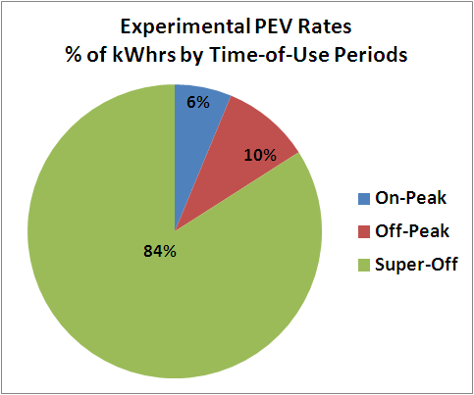
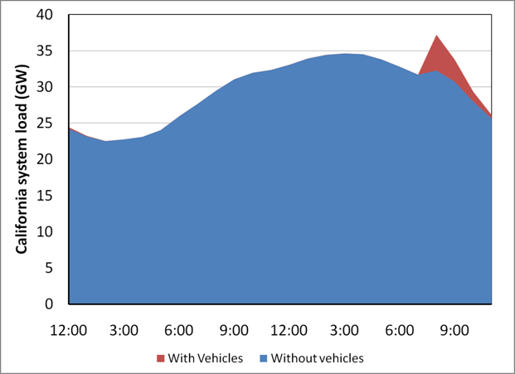
PEV Charging
Plug In Electric Vehicle (PEV) Impact
As of Year End 2011
Vehicles: Total ~1200 (Nissan LEAF, GM Volt, Tesla, conversions & misc.)
Approximately 8 kWh consumption per vehicle/day
Public Chargers Installed: 69 with ~10x more chargers in process
Power demand from “badly” controlled charging – a new, potentially disruptive peak
Controlled overnight charging could result in no increase in peak load
Approximately 35% of PEV experimental rate participants are customers with solar photovoltaic systems

Slide 10
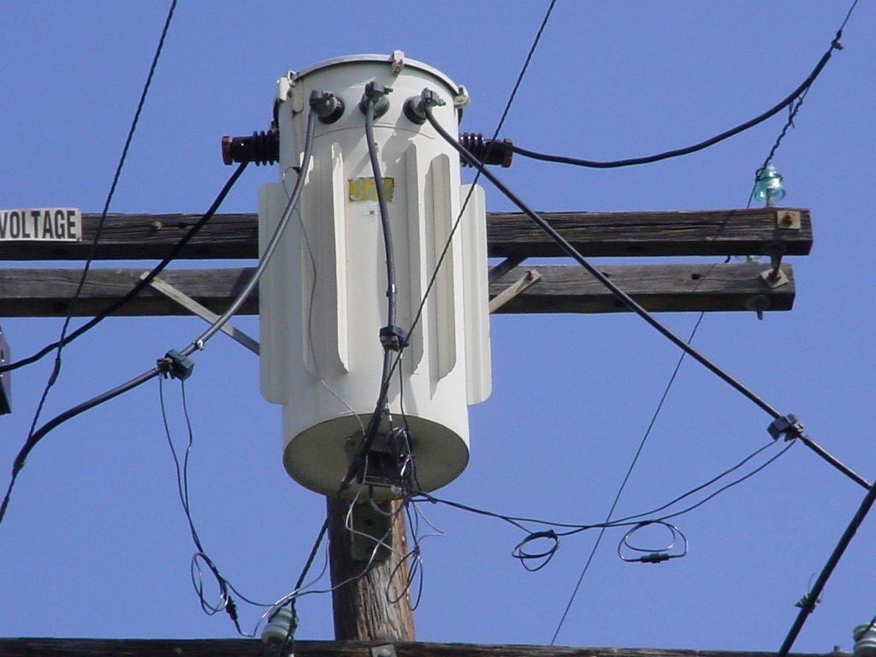
Smart Transformer Testing
10

Slide 11
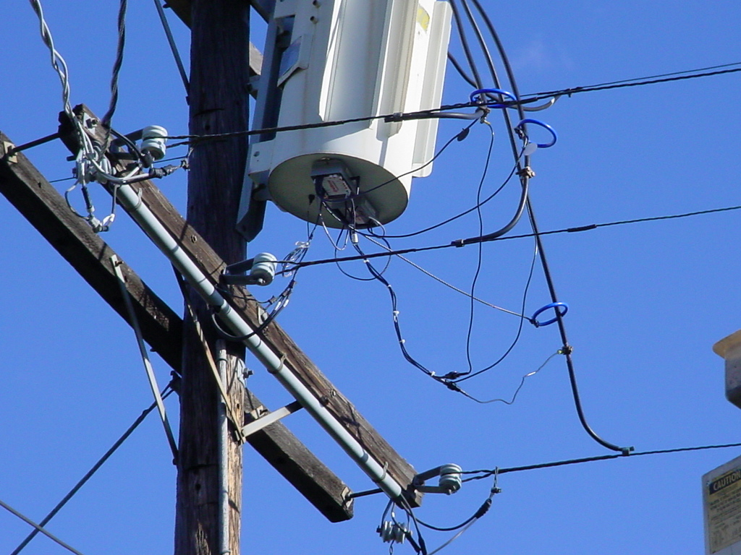
Smart Transformer Testing
11

Slide 12
Capacitor SCADA
Description:
Convert existing distribution line capacitors to SCADA units.
Provide better volt/VAR management supporting integration of distributed generation
Provide better monitoring of capacitor condition, reducing chance of forced failure
12

